Slide 1
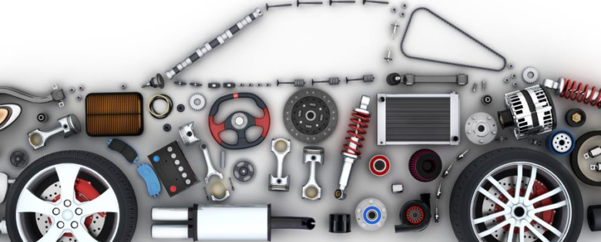
Analyzing the Impact of Car Features on Price and Profitability
By Rohit paul

Slide 2
Overview
This project is based on optimizing the price and making proper product development decisions of a car manufacturer to maximize profitability while meeting consumer demand.
The automotive car industry is growing rapidly for past few decades. With the growth of these industries, several new technologies are adopted.
With his evolving, car industry increasing focus on fuel efficiency, environmental sustainability, and technological innovation. With increasing competition among manufacturers and a changing consumer landscape.
In the current scenario, it has become more important to understand the factors that drive consumer demand for cars than ever.

Slide 3

Tech-stack used
For this project, Excel is used to visualize the data while solving the queries and Power Bi is used to create interactive charts and dashboards.
After the queries are solved and charts are prepared, a well explained presentation is created using Powerpoint.
The dashboard link: https://drive.google.com/file/d/16Vvmx_BiJkkLKK7KBn9iq8MLQ4BBpKj1/view?usp=share_link
The excel file link: https://docs.google.com/spreadsheets/d/1S7rij0tDbyqH7G0-WG0YI9YyzPP6Ci7J/edit?usp=sharing&ouid=101360921551009065004&rtpof=true&sd=true

Slide 4

Approach
The datasheet is already provided in the from of .csv format.
After importing the data into excel, number of tasks are performed to understand and clean the datasheet. The tasks are:
Understanding the columns, data. Trying to get an overview of the data.
Dropping rows with missing and duplicate data.
Creating pivot tables and charts to analyze the data properly.
After the data is cleaned, correlation matrix is created using data analysis tool from excel and pivot tables are created.
Then the file is loaded into power bi to create charts from it and using measures create needed columns such as “Avg_MPG” and later an interactive dashboard is created.

Slide 5
Charts and Insights

Slide 6
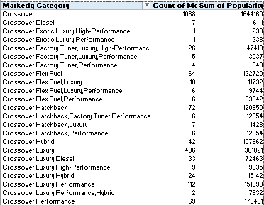
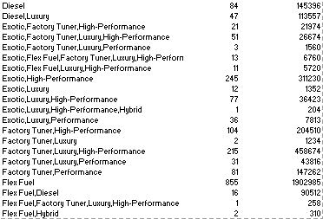
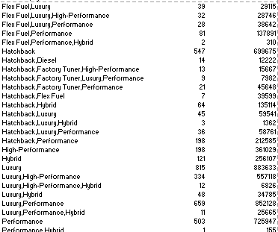
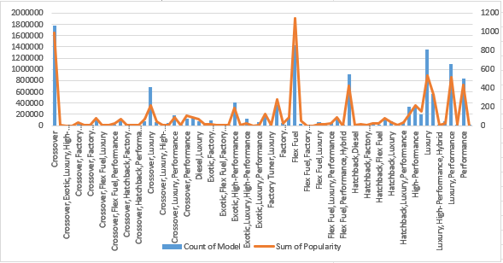
Car model popularity across different market categories
Task 1.A: Pivot table:
Task 1.B: Chart:
From the pivot table we can see that, the top 5 most popular car marketing categories are:
Crossover
Flex-fuel
Hatchback
Luxury
Performance

Slide 7
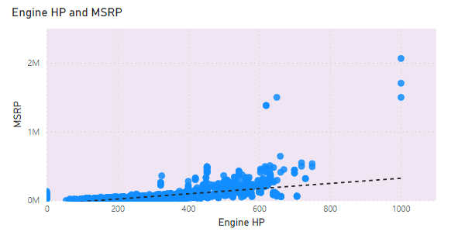
Relationship between a car's engine power and its price
Task 2: Scatter Plot:
From the scatter plot, we can see that the MSRP increases along with increasing engine horsepower.

Slide 8
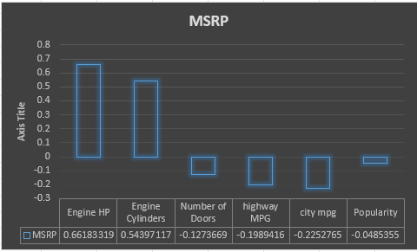
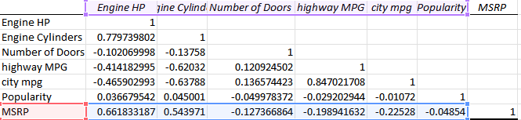
Features determining a car's price
Task 3: Co-efficient table:
From the coefficient table we can see that , Engine HP and Engine cylinders have the highest coefficient value determining the MSRP.

Slide 9
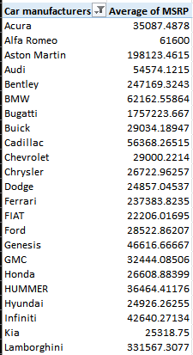
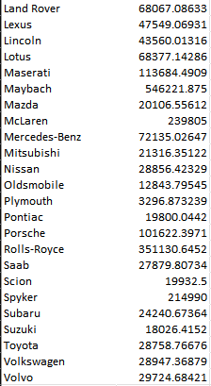
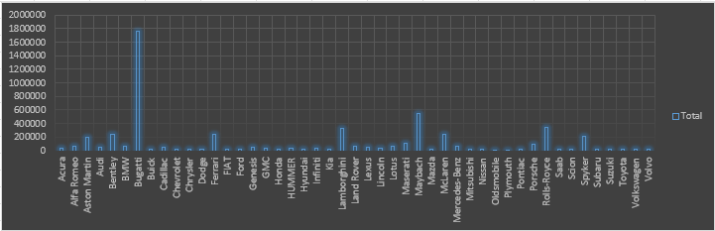
Average price of a car across different manufacturers
Task 4.A: Pivot table:
Task 4.B: chart:
From the pivot table and chart we can see that, the top 5 car manufacturers with highest average MSRP are:
Bugatti
Maybach
Rolls-Royce
Lamborghini
Bentley

Slide 10
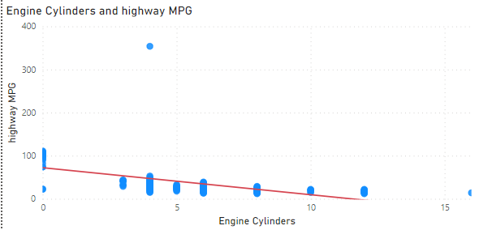
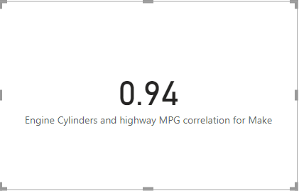
Fuel efficiency & the no. of cylinders in car e relation
Task 5.A: Scatter-plot:
Task 5.B: Coefficient value: We used The Quick Measure Feature Of Power Bi to Calculate the
Correlation Coefficient Where We took Make Column as the Category Number Of cylinders on
X Axis and Highway MPG on Y Axis.

Slide 11
Conclusion
The analysis depicts the most popular car manufacturers and focuses on the cars which are costlier than other brands available in the market.
During The Analysis, We noticed How the Car price fluctuates depending on various factors. In this study we saw how the Engine HP, MPG Of Car And Cylinder numbers alone creates a huge difference in Price Of the Cars.
After the analysis, we have also created an interactive dashboard with the help of Power bi. The dashboard helps to understand the analysis further which helps in creating clearer insights.

Slide 12

Thank you

